Slide 1
TELCO CUSTOMER CHURN ANALYSIS
Promise Omoruyi
Data Analytics Intern
Business Analytics Case Study
AnalystLab Africa Data Analytics Internship — Week 1
Promise Omoruyi
Data Analytics Intern

Slide 2
Business Problem & Objectives
Business Problem
ABC Communications Ltd is experiencing customer churn, which can negatively affect revenue and customer retention. This analysis examines customer characteristics and identifies factors associated with customer churn.
Objectives
Understand the customer base.
Identify customer segments with high churn.
Examine the influence of contract type and tenure on retention.
Identify services and payment methods associated with churn.
Provide actionable recommendations to improve customer retention.

Slide 3
Dataset Overview
Dataset: Telco Customer Churn Dataset
Records: 7,043 customers
Key Variables:
Demographics
Contract type
Tenure
Internet and other services
Payment method
Monthly charges
Total charges
Churn status
Data Preparation
Checked missing values
Checked duplicates
Reviewed data types
Cleaned and prepared data for analysis
Used PivotTables and charts for business analysis

Slide 4
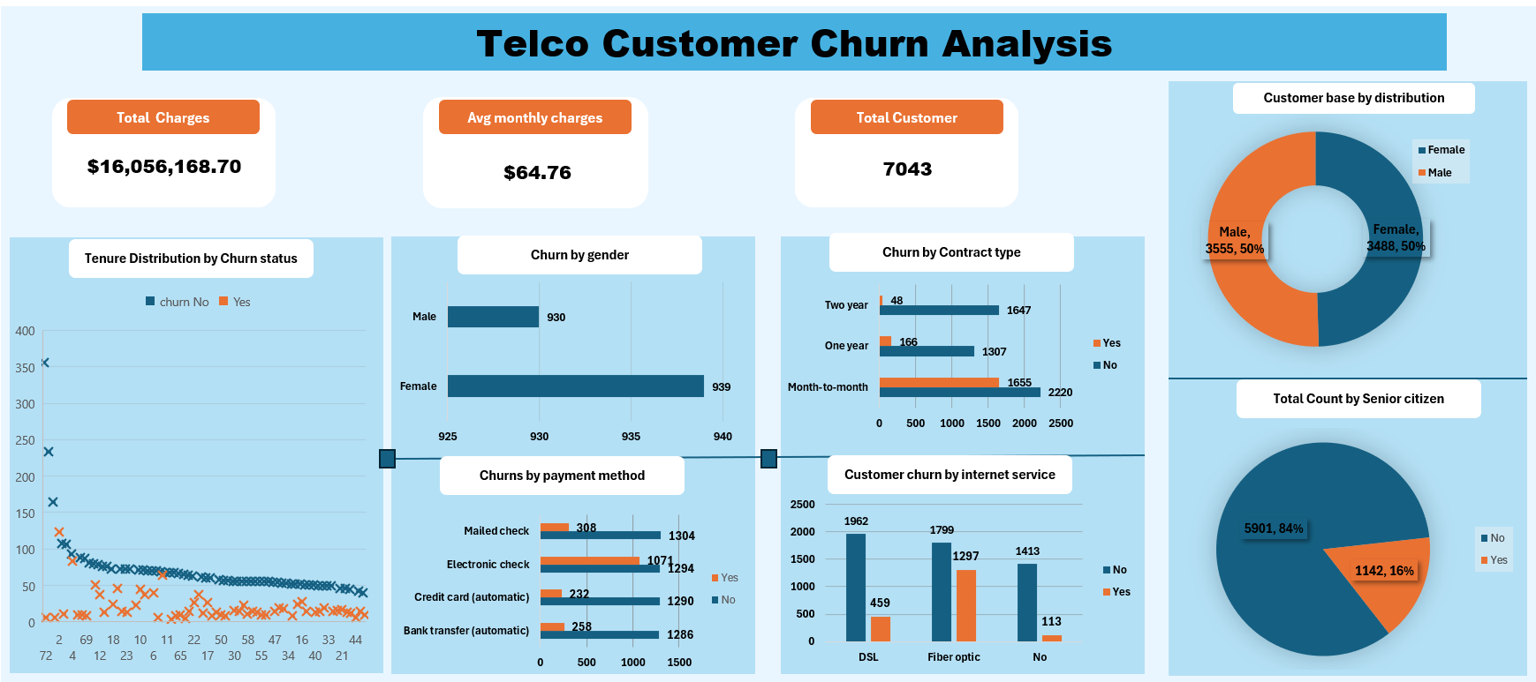
Key Business Insights
The dashboard highlights key patterns in customer churn across contract type, tenure, internet service, payment method and customer demographics.

Slide 5
Business Risks
Revenue loss from high customer churn Continued customer departures may reduce recurring revenue.
High dependence on month-to-month customers The high churn within this group creates customer retention risk.
Potential loss of high-value service customers High churn among fiber optic customers could negatively affect revenue and customer lifetime value.

Slide 6
Business Opportunities
Increase long-term contracts Encourage month-to-month customers to move to one-year or two-year plans.
Improve the fiber optic customer experience Investigate service quality, pricing and customer complaints.
Improve payment options Encourage customers using electronic checks to adopt convenient alternative payment methods.

Slide 7
Recommendations
Introduce loyalty incentives for month-to-month customers.
Offer incentives for long-term contracts to improve retention.
Investigate fiber optic customer complaints and service quality.
Promote alternative payment methods to electronic-check users.
Develop targeted retention campaigns for customers at high risk of churn.

Slide 8
Conclusion
The analysis shows that customer churn is strongly associated with contract type, tenure, internet service and payment method. Month-to-month customers, fiber optic users and electronic-check users represent important areas for retention efforts. By introducing targeted retention strategies, improving customer experience and encouraging longer-term contracts, ABC Communications Ltd can reduce churn and strengthen customer loyalty.

